Slide 1

Chapter 6: Communicating Across Cultures
Week 13
Lecture 1

Slide 2


CULTURE
Culture includes the values, attitudes, beliefs, orientations, and underlying assumptions prevalent among people in a society.

Slide 3

Intercultural Communication
Communication between people from different cultures
ONLY when the difference in cultures poses a problem or is very noticeable

Slide 4
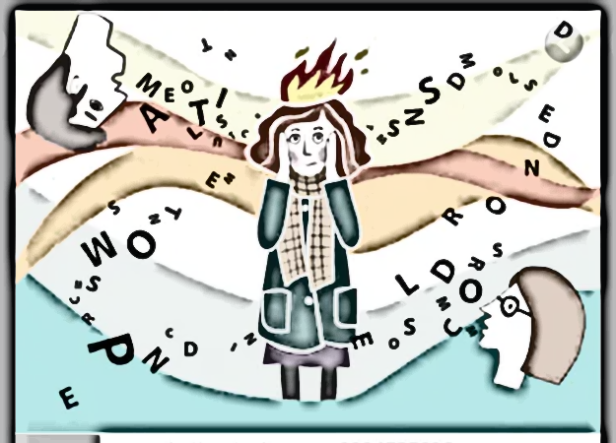
Culture Shock
Psychological discomfort upon interacting with a completely different culture

Slide 5

Dominant Culture and Co-Cultures
Dominant Culture : shared by majority of its members
Co-Cultures : smaller groups whose cultural beliefs, habits, ways of living, communication practices, and perceptions differ from the dominant culture

Slide 6
Factors that affect intercultural communication
Race: biological characteristics; racial identity; different ways of communication that might not match with others
Ethnicity: can impact communicational practices if the speaker has strong ethnic identity
Gender: difference in ways of expression and communication patterns

Slide 7
Factors that affect intercultural communication
Religion: can impact language and communication if speaker has strong religious identity
Social Class: Elite, Bourgeois (Middle Class), Poor; can impact ways of living and communication habits
Age: Generation gaps
Cultural Identity: self-concept; strong = impact on communication habits

Slide 8

Cultural Norms and Values, and Communication
Individualism – Collectivism
Uncertainty Avoidance
Power Distance
Masculinity – Femininity

Slide 9
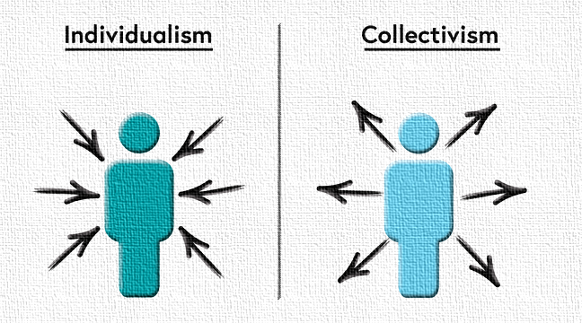
INDIVIDUALISM
COLLECTIVISM
Focus on individual
The self comes first
Competition is desirable
Emphasize personal rights and responsibilities, privacy, expressing yourself, freedom, innovation
Personal achievements are valued even if the community is not involved
Inclined to defend themselves in conflict
Can argue or confront the other party directly in case of a misunderstanding or conflict
Focus on community
The community comes first
Do not prefer competition; harmony and collaboration is preferred
Emphasize shared goals, harmony, teamwork, shared interests, the public good, avoiding embarrassment
Personal achievements are not valued if it is not the community’s win
Avoid arguments and conflicts by choosing not to say anything
Prefer discussing the issue in detail and working through dialogue rather than a confrontation

Slide 10

Uncertainty Avoidance
Low uncertainty avoidance cultures – can tolerate uncertainty and ambiguity; can converse with strangers easily
High uncertainty avoidance cultures – cannot tolerate uncertainty and ambiguity and require precise details in communication; are very wary of strangers and prefer not talking to them

Slide 11
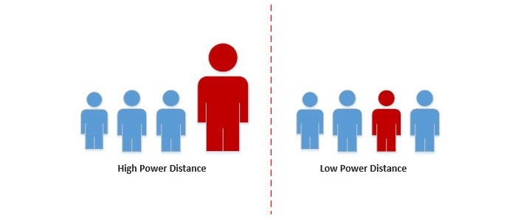
Power Distance
High power distance cultures – very noticeable inequalities in power, status and rank; everyone knows and maintains the hierarchy; polite and formal language; expect higher authority to handle and control the situations
Low power distance cultures – power inequality is not very noticeable; people don’t work actively to maintain power differences; don’t feel inclined to use polite and formal language with superiors; can take charge and control of situations themselves

Slide 12

Masculinity – Femininity
Masculine Cultures – value and maintain gender roles very strictly; men and women remain within their own specific spheres
Feminine Cultures – do not maintain gender roles; men and women can move around in each other’s spheres freely

Slide 13

Barriers to Effective Communication
Anxiety
Assuming Similarity or Difference
Ethnocentrism
Stereotypes and Prejudice
Incompatible Communication Codes
Incompatible Norms and Values

Slide 14

Intercultural Communication Competence
Adopt Correct Attitudes – open-mindedness, altruism, tolerance
Acquire knowledge about other cultures – observe, study, immerse yourself in the other culture
Develop culture-specific skills – listen, empathy, flexibility

